Slide 1

W3C Web of Things (WoT) Introduction, Status and Roadmap
Takuki Kamiya (Fujitsu)
12 September 2019

Slide 2





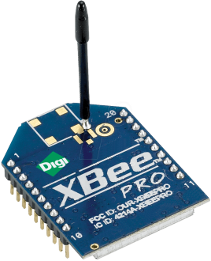
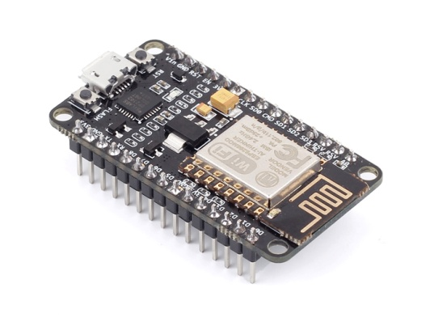
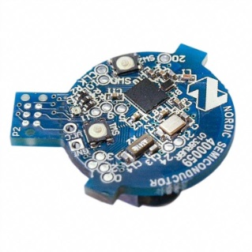
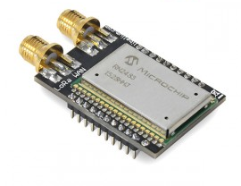
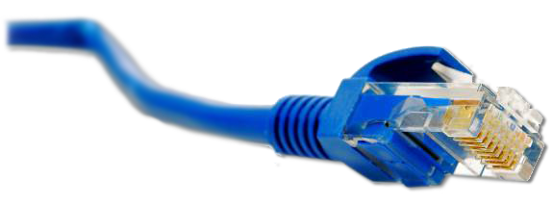
Web of Things (WoT) in a Nutshell
Web of Things (WoT): Applications
Horizontal application layer for the IoT similar to the World Wide Web for the Internet
…
Internet of Things (IoT): Connectivity
: Connectivity
…
Ethernet
LPWAN (LoRa, Sigfox, NB-IoT, …)
Wi-Fi
IEEE 802.15.4 (ZigBee/6LoWPAN/Thread)
Bluetooth

Slide 3



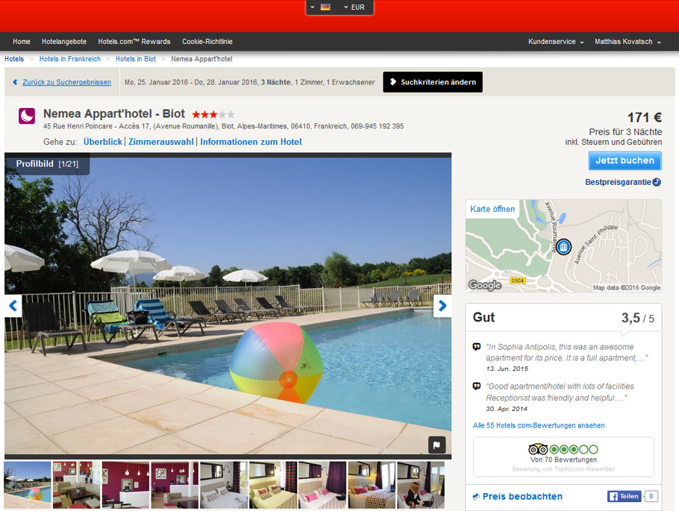




Why the Web – User- and Developer-friendly
Profiles 30,308
Internet of Things
Domain expertise
Embedded developers
Optimized protocols and formats
Silos with high integration costs
World Wide Web
Interoperability and usability
Web developer community
HTTP, JSON, scripting
Easy with high productivity
Web of Things
Take patterns that worked for the Web
Adapt and apply them to the IoT
Open source culture
Profiles 873,202
Notes:
Add figure of developer profiles (80-20 story)
Hotels mashup

Slide 4
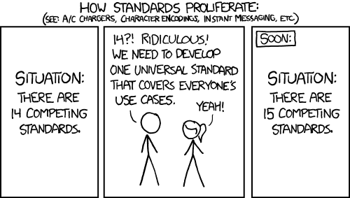
W3C WoT Mission – Not Yet Another IoT Silo

Slide 5

W3C WoT Mission – Describe and Complement
Web of Things: “glue in between”
…

Slide 6

W3C Web of Things – Building Block Approach
REC Track
WoT Architecture
Overarching umbrella with architectural constraints and guidance on how to use and combine building blocks.
WoT Thing Description (TD)
Security Guidelines
WoT Scripting API
REC Track
JSON-LD representation format to describe Thing instances with metadata. Uses formal interaction model and domain-specific vocabularies to uniformly describe how to use Things, which enables semantic interoperability.
Standardized JavaScript object API for an IoT runtime system similar to the Web browser. Provides an interface between applications and Things to simplify IoT application development and enable portable apps across vendors, devices, edge, and cloud.
WG Note
Any IoT Device
Common Runtime
Application Script
Scripting API
The index.html
for Things
Interaction Model
Data Model
WoT Binding Templates
Properties
Protocol Bindings
Capture how the formal Interaction Model is mapped to concrete protocol operations (e.g., CoAP) and platform features (e.g., OCF). These templates are re-used by concrete TDs.
Actions
Events
HTTP
…
CoAP
MQTT

Slide 7

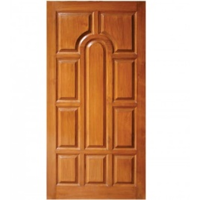

Published Candidate Recommendations
WoT Architecture
Constraints
Things must have TD (W3C WoT)
Must use hypermedia controls (general WoT)
URIs
Standard set of methods
Media Types
Interaction Affordances
Metadata of a Thing that shows and describes the possible choices (what) to Consumers, thereby suggesting how Consumers may interact with the Thing
WoT Thing Description (TD)
{
"@context": [
"https://www.w3.org/2019/wot/td/v1",
{ "iot": "http://iotschema.org/" }
],
"id": "urn:dev:org:32473:1234567890",
"name": "MyLEDThing",
"description": "RGB LED torchiere",
"@type": ["Thing", "iot:Light"],
"securityDefinitions": ["default": {
"scheme": "bearer„
}],
"security": ["default"],
"properties": {
"brightness": {
"@type": ["iot:Brightness"],
"type": "integer",
"minimum": 0,
"maximum": 100,
"forms": [ ... ]
}
},
"actions": {
"fadeIn": {
...
Pull
Handle = Affordance
What?
How?
Door = Thing
Open
Turn

Slide 8
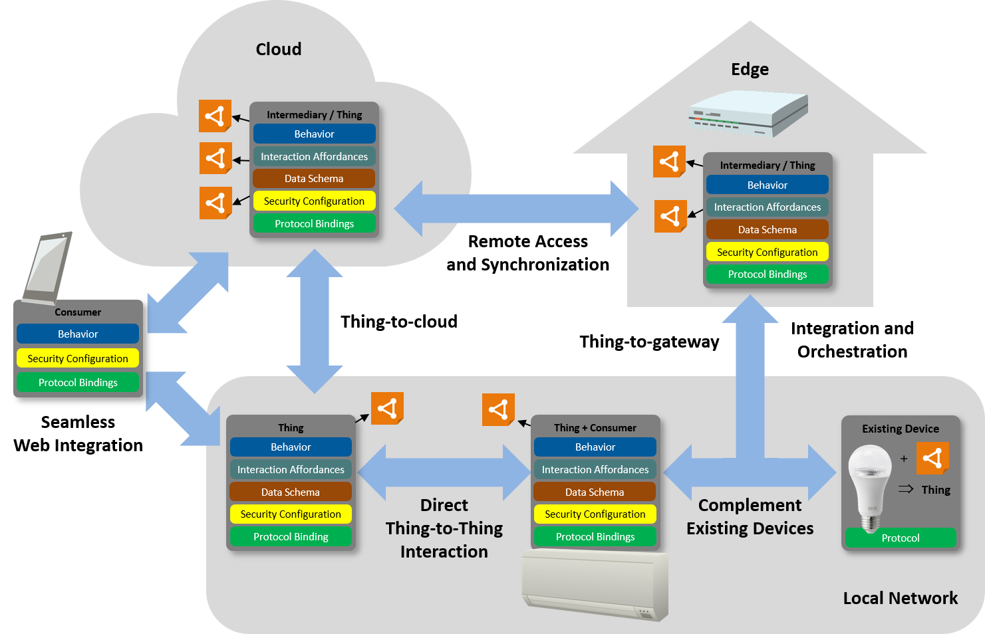

Abstract WoT Architecture

Slide 9
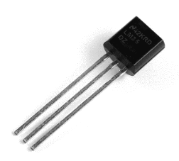
Alignment with SOSA/SSN (Example)
Thing Description Information Model
td:InteractionAffordance
td:Thing
td:Property
Thing Description
Instance
ex:TemperatureSensor01 Thing
ex:TemperatureSensor01 Temperature Property
td:properties
SOSA/SSN
ex:isRepresentedBy
ssn:forProperty
ex:TemperatureSensor01
ex:AverageTemperature
ssn:Property
sosa:observes
ssn:isPropertyOf
sosa:FeatureOfInterest
sosa:Sensor
ex:Room

Slide 10
Example Thing Description
{
"@context": [
"https://www.w3.org/2019/wot/td/v1",
{
"saref": "https://w3id.org/saref#",
"ssn": "http://www.w3.org/ns/ssn/"
}
],
"id": "urn:dev:ops:32473-WoTLamp-1234",
“@type": "saref:LightSwitch",
"saref:hasState": {
"@id": "urn:dev:ops:32473-WoTLamp-1234/state",
"@type": "saref:OnOffState"
},
"properties": {
"status": {
"ssn:forProperty": "urn:dev:ops:32473-WoTLamp-1234/state",
"type": "string",
"forms": [{"href": "https://mylamp.example.com/status"} ]
},
"actions": {
"changeStatus": {
"ssn:forProperty": "urn:dev:ops:32473-WoTLamp-1234/state",
"forms": [{"href": "https://mylamp.example.com/changeStatus"} ] }
}, ...
State
Interaction
Affordance

Slide 11
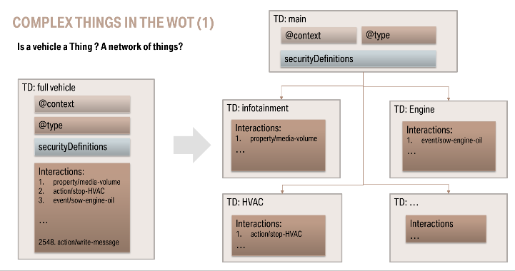
Complex Things in WoT (Issue)
Considered a high prioriity – To be addressed in soon after Thing Description v1 release.
Reported by Benjamin Klotz (Eurecom) @ 2nd W3C Workshop on WoT in June 2019

Slide 12
Roadmap / Next steps
Proposed RECOMMENDATION Publication of Architecture and Thing Description: expected in Sep 2019
New charter of the WoT Working Group currently being defined
Charter Period: November 2019 – October 2021 (Still under discussion)
1st WoT Working Group face-to-face meeting under the new charter expected in Singapore (November 2019)
Please participate and contribute to the evolution of the Web of Things

